Slide 1
Data Analysis & Machine Learning Using Python Internship
Team Name :- NASDAQ
Project :- Stock Price Prediction
Group: 15
Group Members :
Tushar Kumar
Kavin Kumar Singh

Slide 2
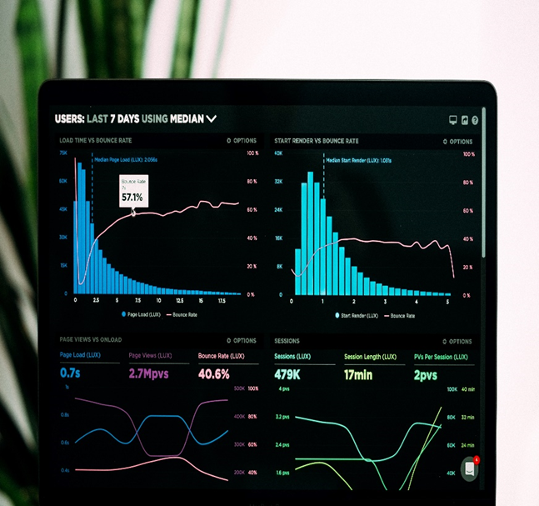
Dataset Description:-
We have downloaded our data from Kaggle website.
Our dataset is a 3-Dimensional dataset in which the outermost dimensional consist of 160 files of .csv file format. All the CSV files contains data from Jan-2017 till Mar-2020.
Timestamp - date when was stock price this one
time in minutes for the stock
High - Means the highest price in a given period of time.
Low - Means the lowest price in a given period of time.
Open - in a stock market refer to the opening price for the stock
Close - the closing price of the stock.
Volume - the total number of people buying the stock.

Slide 3
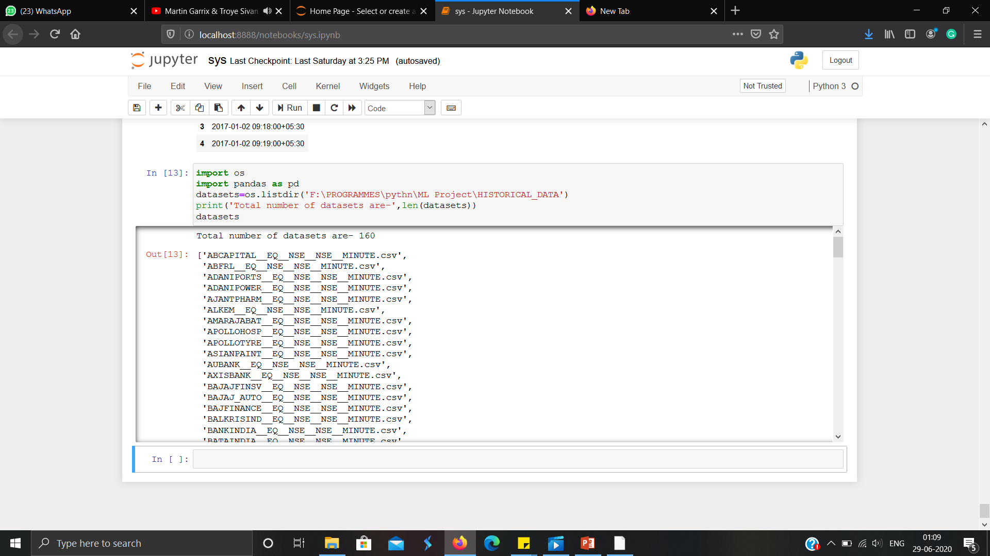
Our dataset consists of multiple CSV files so to invoke a particular file name by its name we have used OS module and provided its location for iteration of selected file.And each CSV contains around 310,486 rows and 6 columns .
Data Representation:-

Slide 4
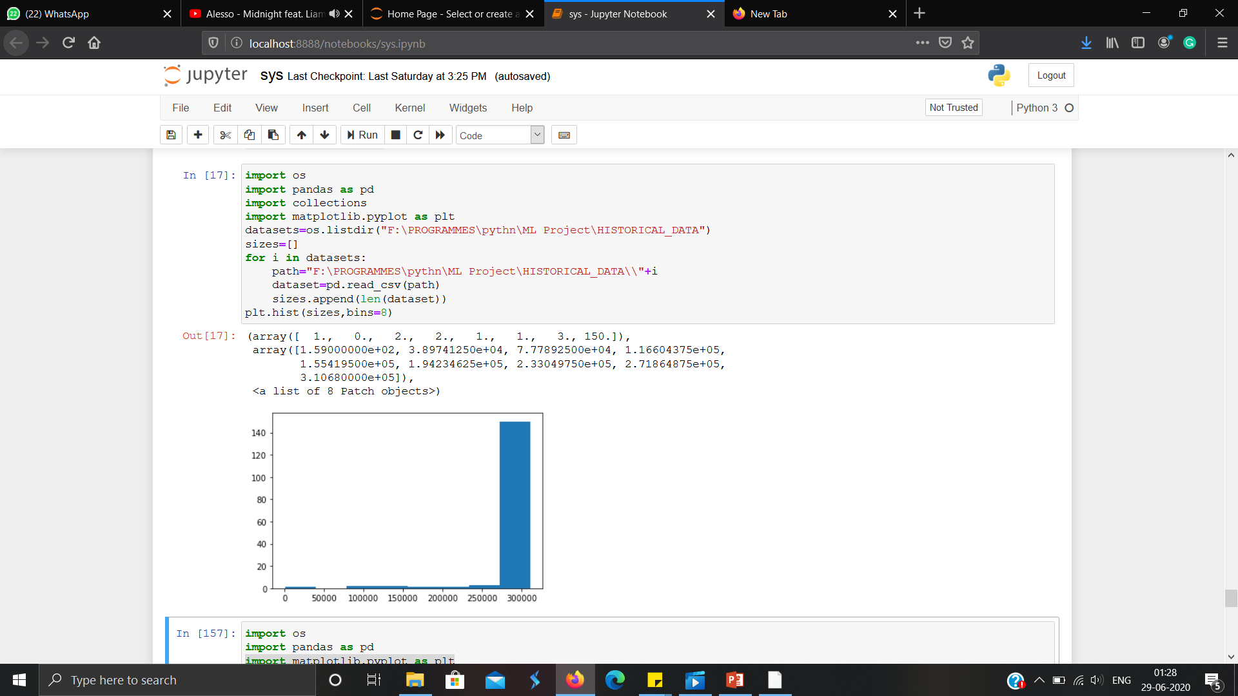
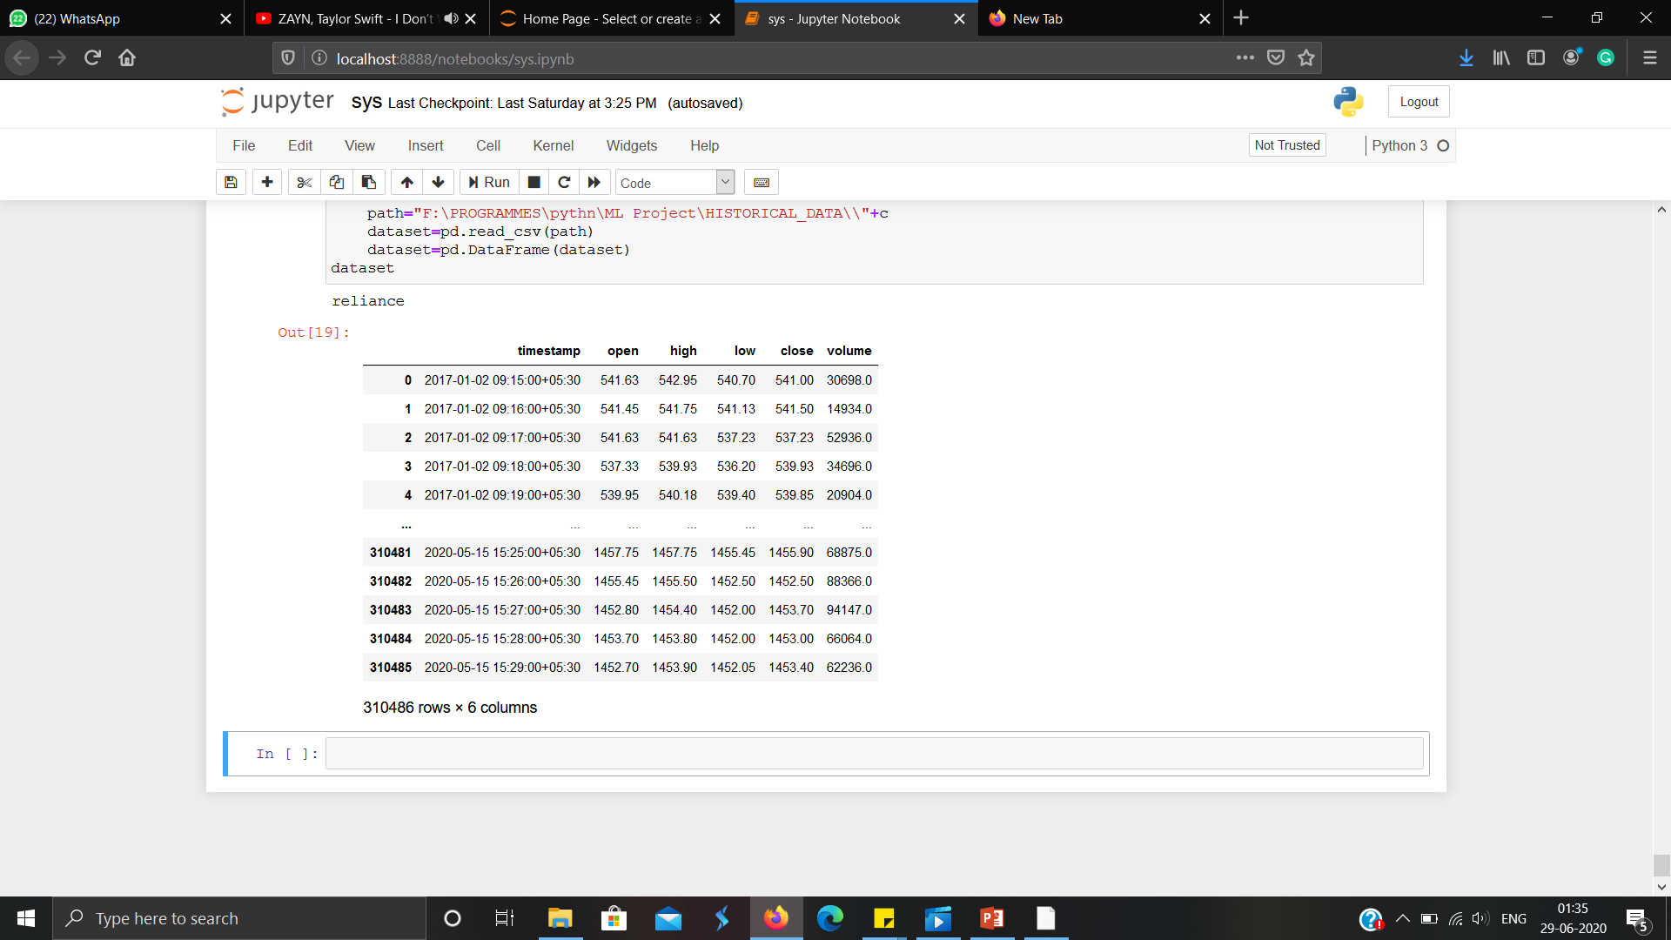
The other two dimensions are the attributes and data itself.
Most of our files in our dataset contains around 3lakhs data and data is taken at a duration of 1 minute.

Slide 5
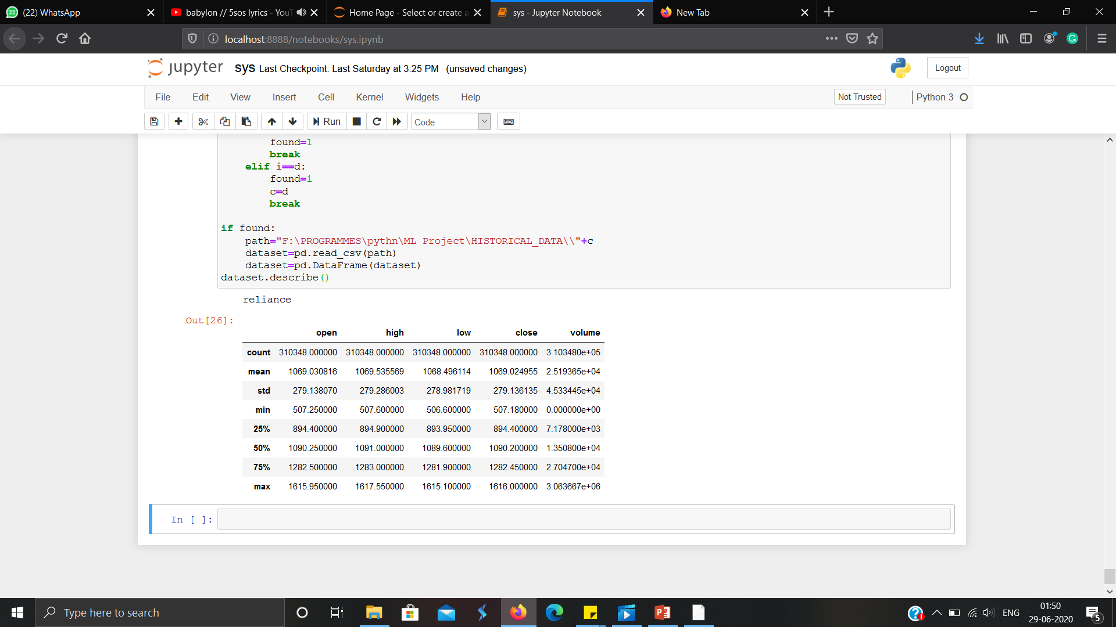
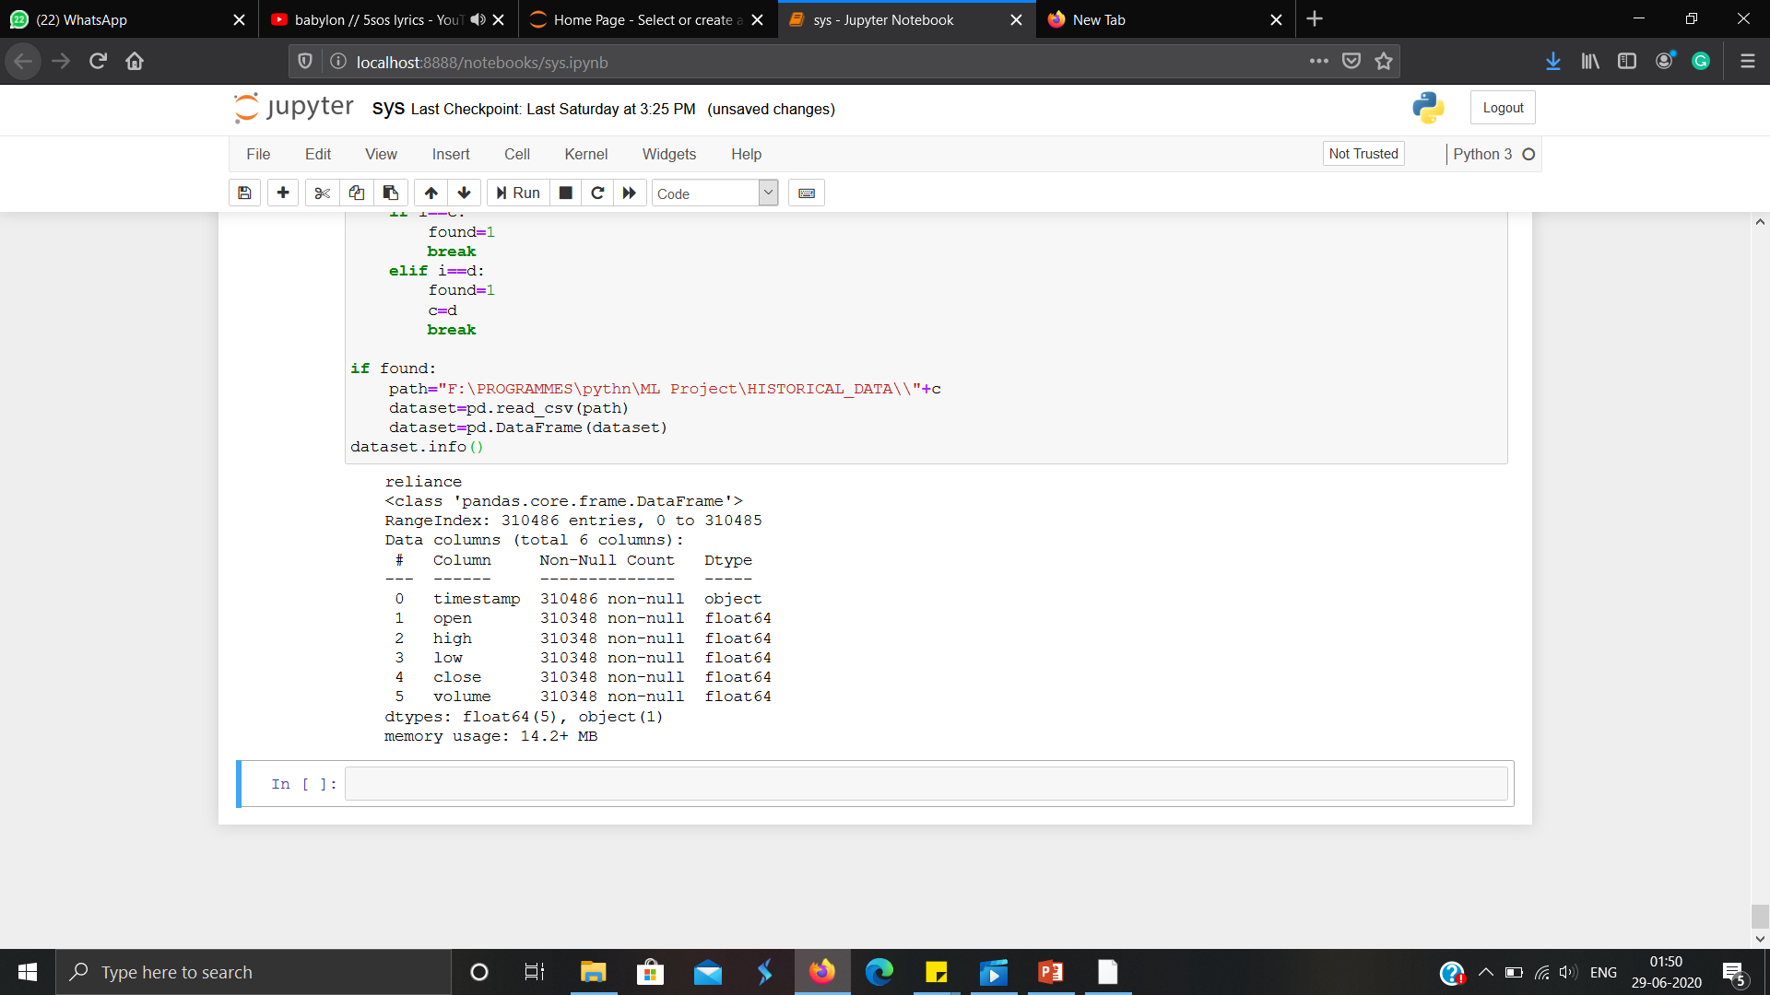
Datatype of each of our attribute.
And defining data using data mean, standard deviation, etc.
Our dataset contains 6 attributes.

Slide 6

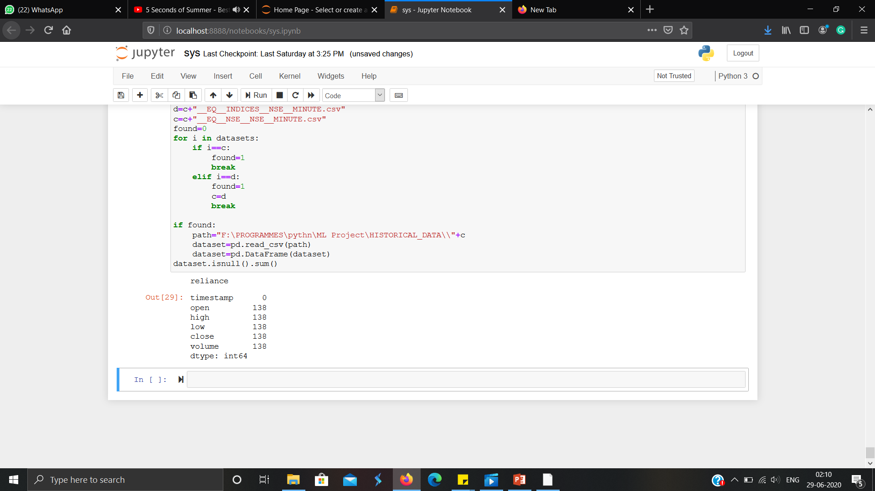
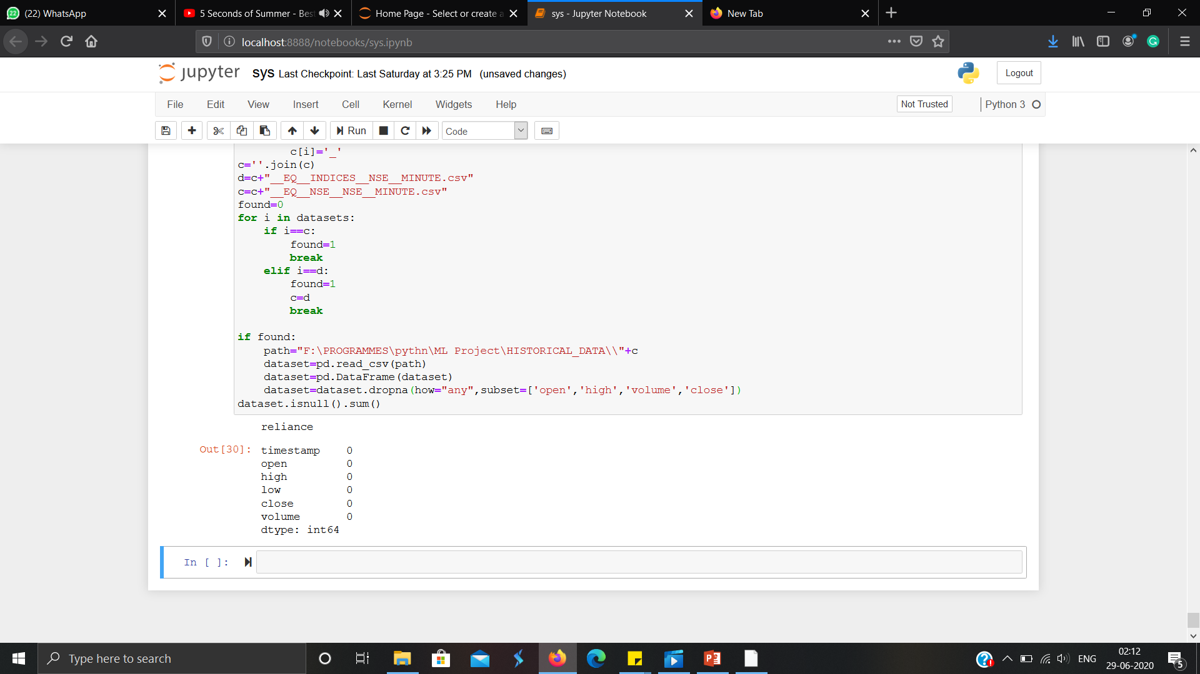
Pre-processing of data:-
The very first thing we do in our data is data cleaning, as we have some null value in our data. So we remove firstly remove then.

Slide 7
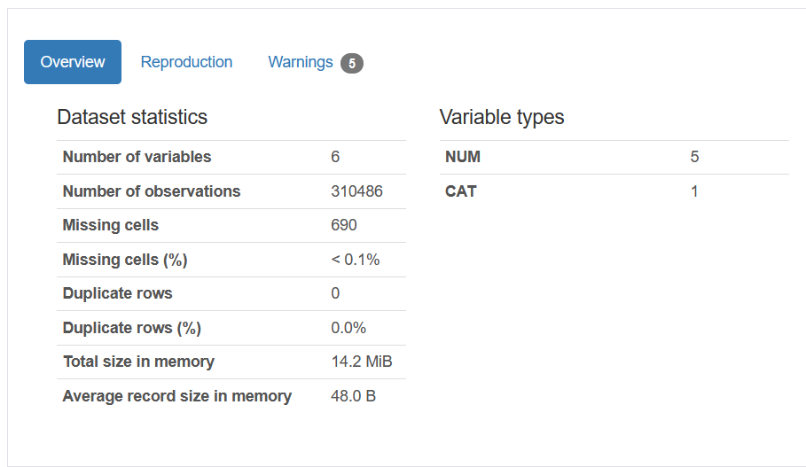
Though we don’t have any duplicate data in our dataset but we still applied commands to remove duplicates.

Slide 8
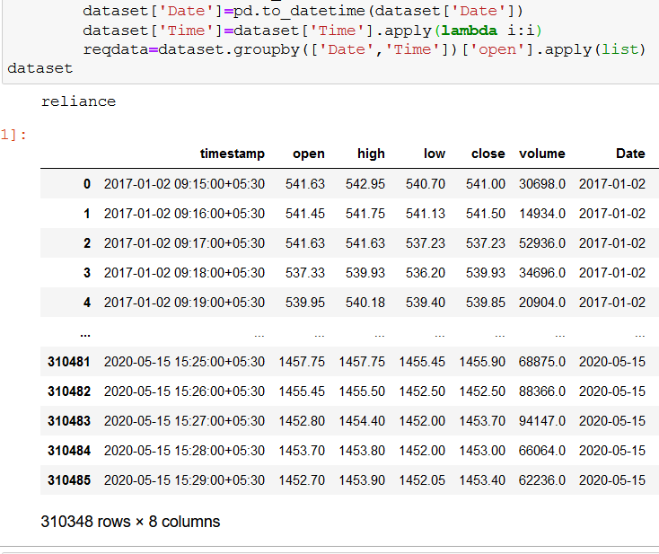
Now we want to predict our data day wise but we have dataset in minutes duration so we need to group our data date wise and for that we need a date column.
So from timestamp we make fetch dates of every data and add then in a new column.

Slide 9
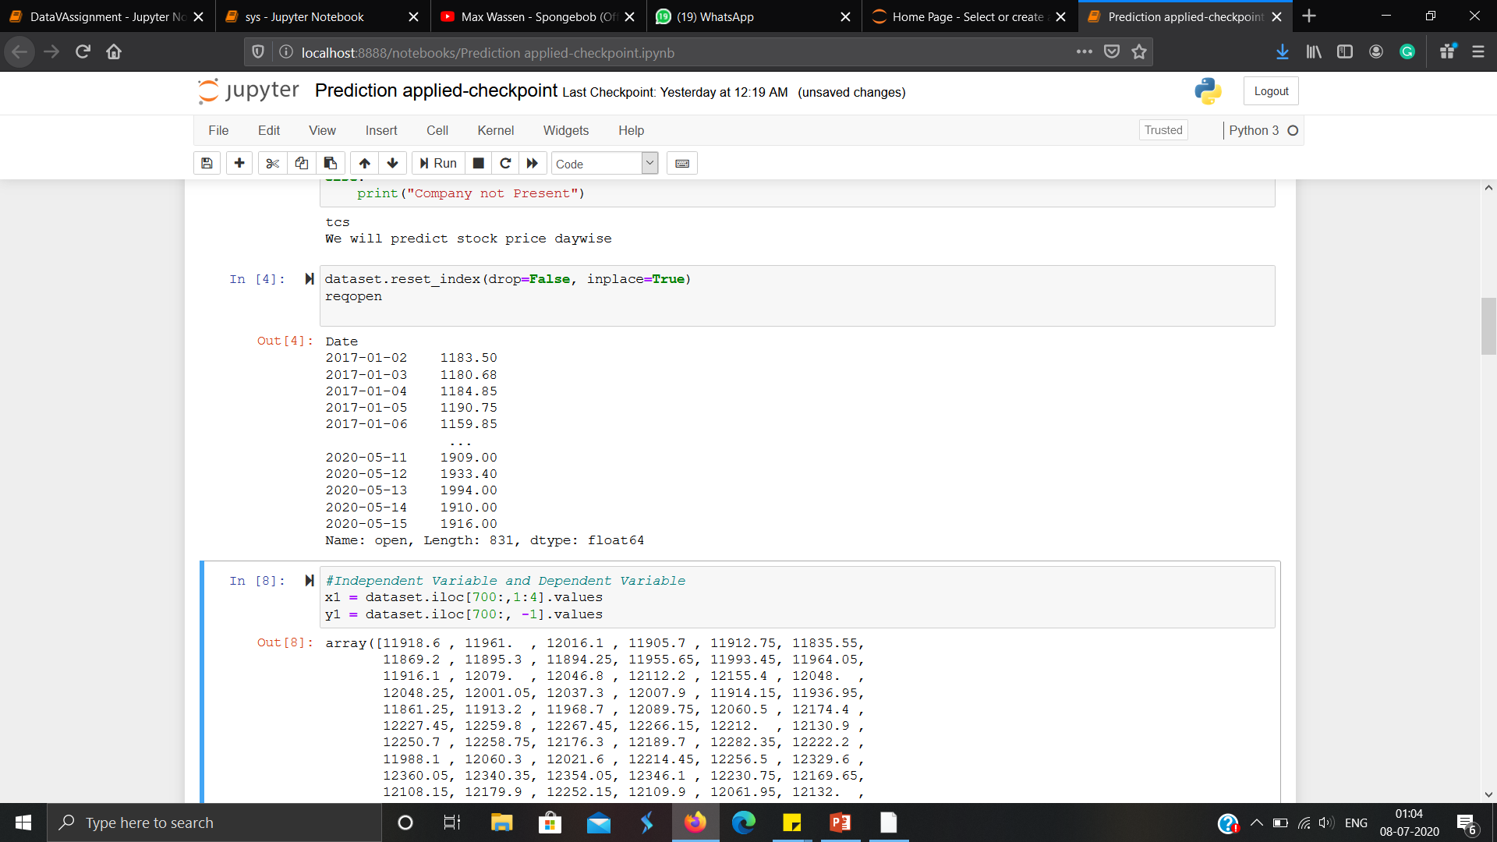

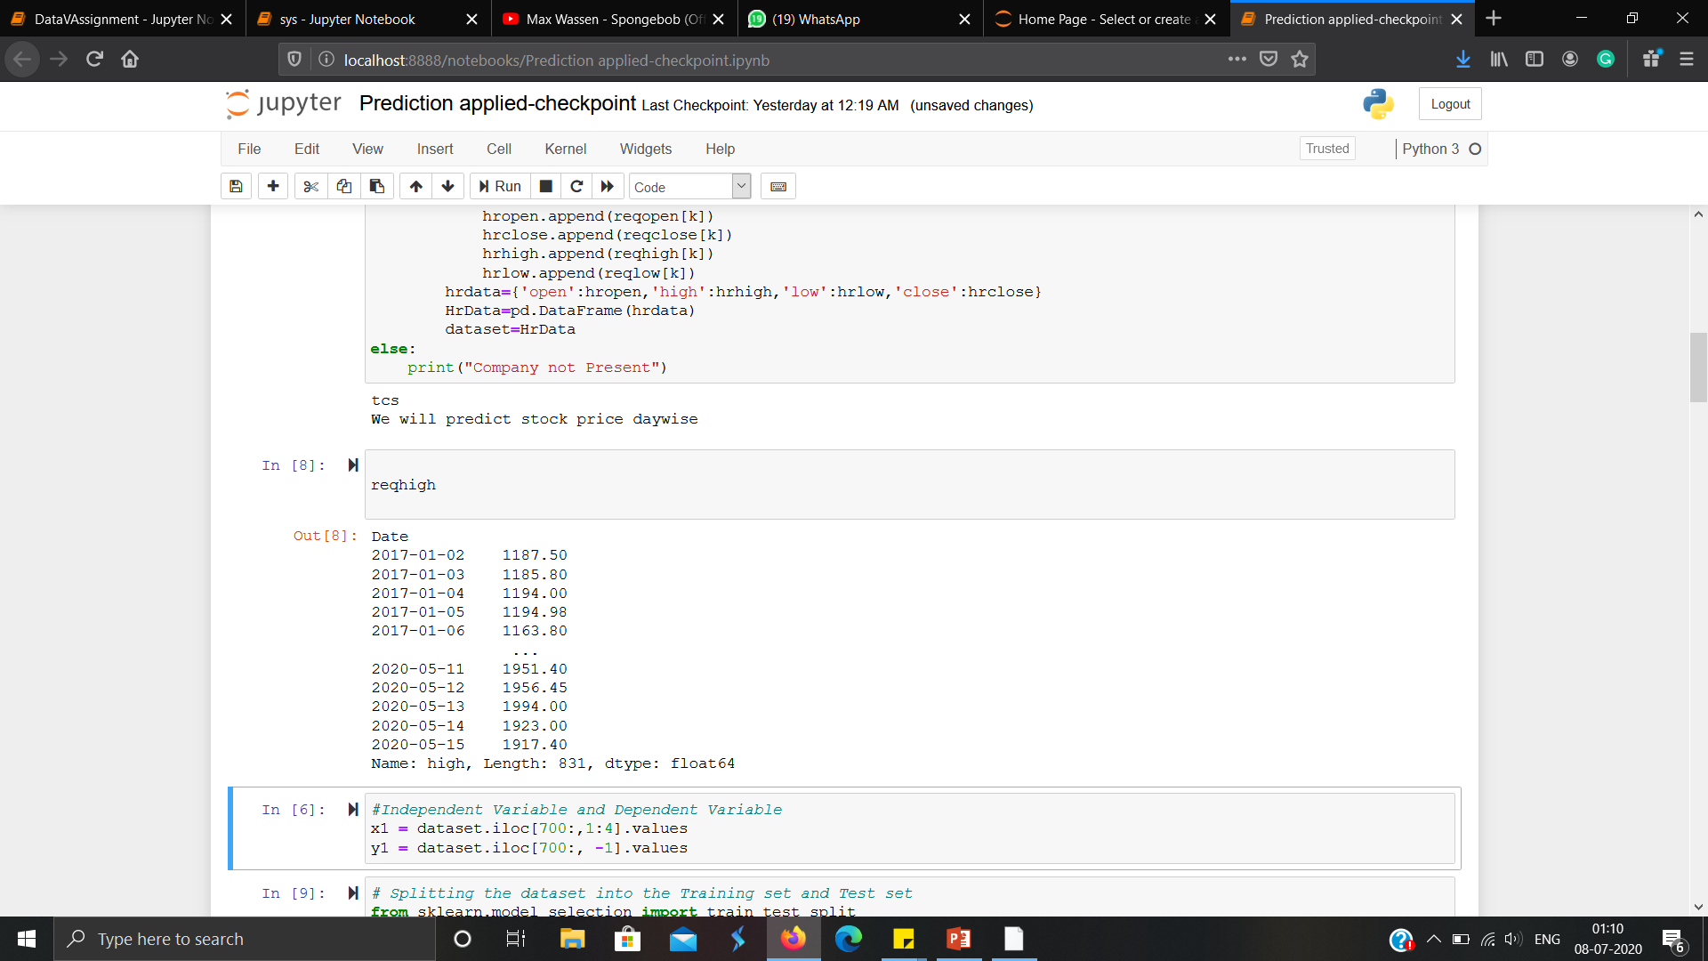

we now group the data according to dates and then manipulate the data.

Slide 10
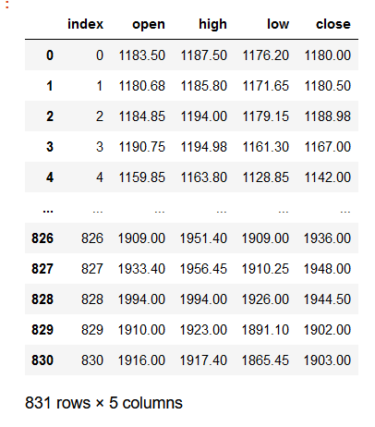
So After grouping we take the first price of open column
Last price of close column
Highest price of high column
And lowest price of lowest column.
Reason behind this is as open is the first one meaning on that day the stock price opens. Close is last means on that day stock close on that price and so on.
And finally we added index column representing as days.

Slide 11
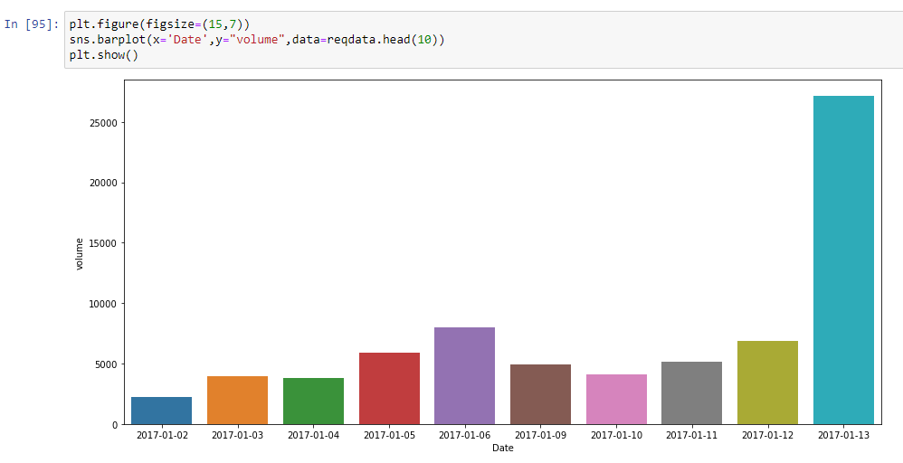
Data Visualization:-
1) Univariate Analysis :- Univariate analysis is the simplest form of analyzing data. “Uni” means “one”, so in other words your data has only one variable.We have applied univariate analysis for the volume of stock sold for 10 days.

Slide 12
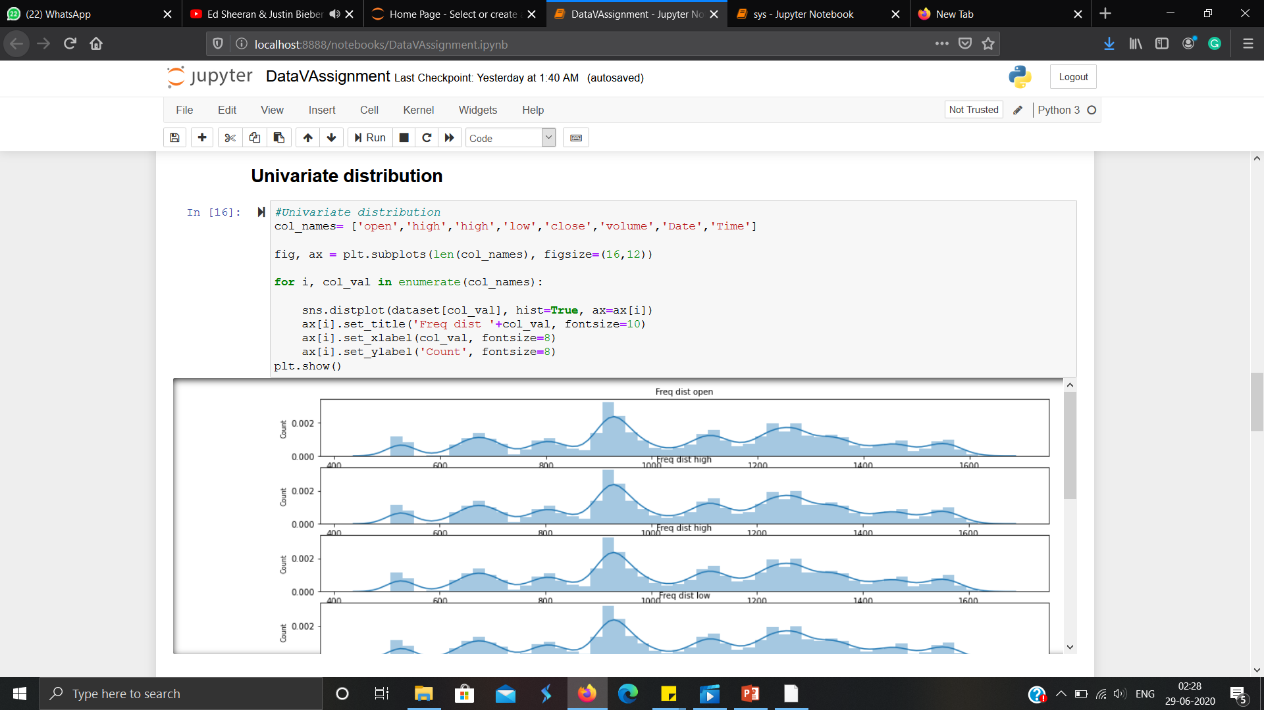
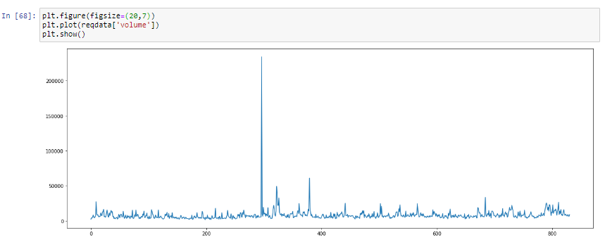
Displaying the univariate distribution

Slide 13
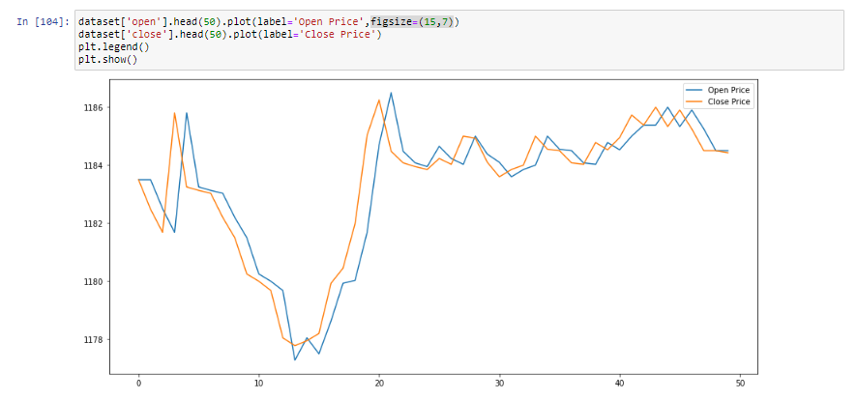
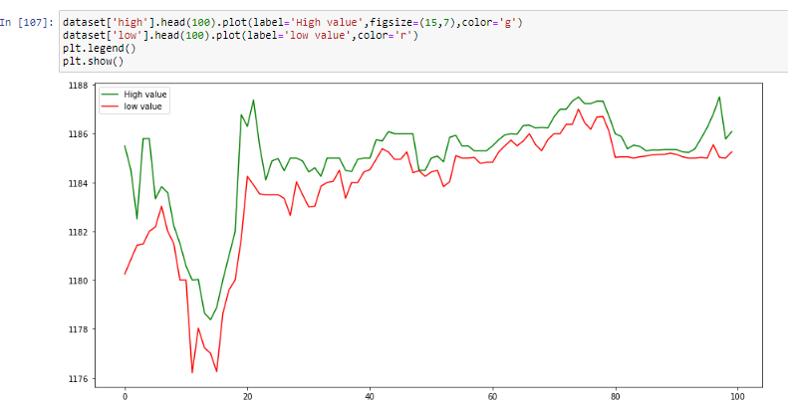
Bivariate analysis:-
1) Bivariate Analysis :- Bivariate data could also be two sets of items that are dependent on each other.

Slide 14
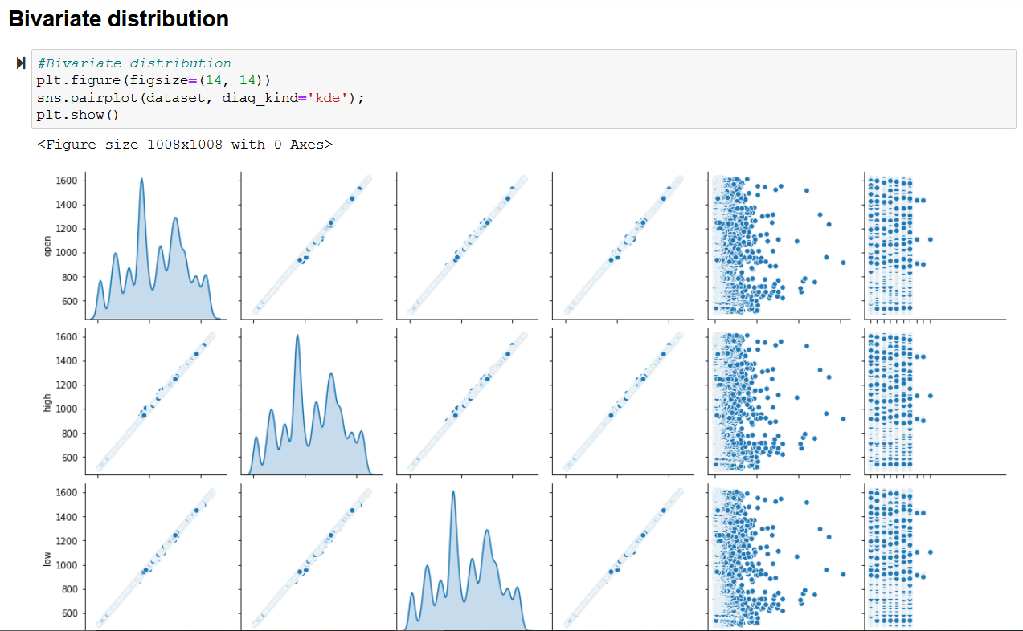
Displaying the bivariate distribution:-

Slide 15
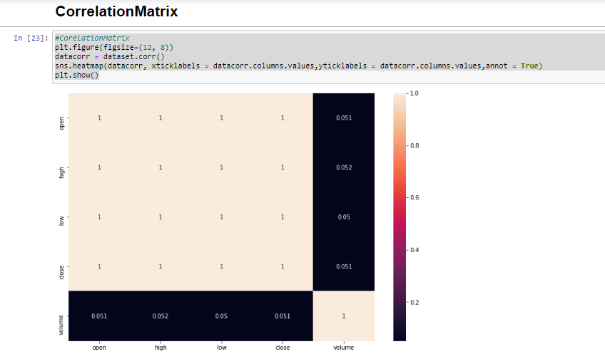
Correlation Matrix:-
A correlation matrix is used to summarize data, as an input into a more advanced analysis, and as a diagnostic for advanced analyses.

Slide 16
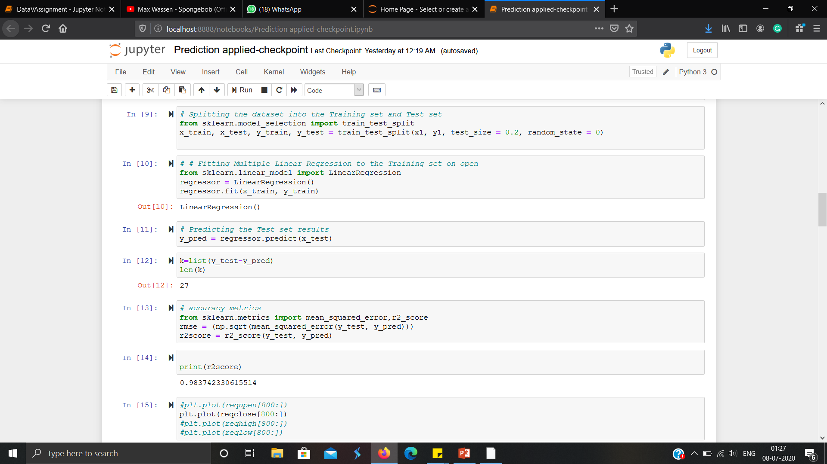

Applying Machine Learning algorithm and Result
Now we applied machine learning algorithm on our processed dataset and the algorithm that we applied is Multiple linear regression we applied this algorithm because our dataset is mostly increasing type means values are increasing and continuous type.
Although we can use linear regression but we didn’t because we require more than 1 independent variables.
We divided our data into two halves 80% for training and 20% for test.
And when we compared our predicted data from original data we get the accuracy of 93-98% depending on the variation of dataset .

Slide 17
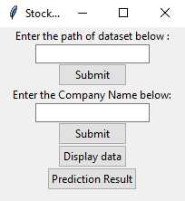
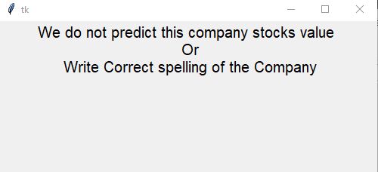
GUI Using Tkinter library
We have created a small Gui model which first fetches the dataset location and then ask the company name from the user for prediction and display the dataset accuracy and root mean square error separately.
If the user Enter a company which is not listed in our data or there is some spelling mistake in the entered company name then:-

Slide 18
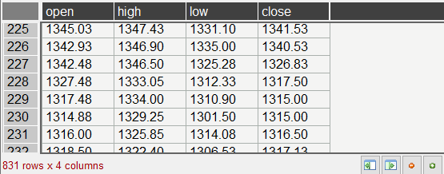
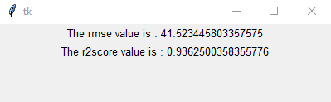
Our dataset inside the GUI looks like this which also tells the number of rows and number of columns of the dataset in the bottom left corner .
The final output is presented as below

Slide 19


